Slide 1
APS1052 Final Project
APPLE Stock Prediction
Group Members: Jiawei Ma, Long Ye, Jingting Chen, Zhaoxi Liu
Date: 2023/04/07
Notes:
Hello everyone, (introducing group members……)
Today we are going to talk about our APS1052 final project: APPLE Stock Prediction.

Slide 2


Introduction
-APPLE (STOCK)
-MACHINE LEARNING (ML) PREDICTION
Notes:
Let's begin by briefly describing the project's context and objective.
Apple Inc. and the value of its stock will be introduced.
Then, we will describe the Machine Learning technique that can be utilized to forecast stock prices.

Slide 3



Apple Inc.
One of the largest and most valuable companies in the world
Known for designing, developing, and selling consumer electronics, computer software, and online services
Worth investing in
Notes:
Apple is a multinational technology company based in Cupertino, California. It was founded in 1976 by Steve Jobs, Steve Wozniak, and Ronald Wayne, and has since grown to become one of the largest and most valuable companies in the world.
Apple is known for designing, developing, and selling consumer electronics, computer software, and online services. Its most popular products include the iPhone, iPad, Mac, Apple Watch, and AirPods.
Apple is also a leader in the digital music, streaming, and entertainment industry, with services such as Apple Music, Apple TV+, and the App Store.
In conclusion, Apple Inc. stocks are worthy to invest. The purpose of this project is to investigate the performance of different machine learning models in predicting the stock prices of Apple.

Slide 4
Machine Learning
Used machine learning to predict Apple stock prices
Models used:
Used Amazon, Google, META, and Netflix stock data to assist in predicting the trend of Apple stock
Study may inform investment strategies
Linear Regression
Random Forest
Decision Tree
K-Nearest Neighbors
Notes:
Predicting stock market trends is a challenging task that has attracted the attention of researchers and practitioners from various fields, including finance, economics, and computer science. One popular approach to forecasting stock prices is to apply machine learning techniques, which leverage other relevant features to learn patterns and make predictions.
In this study, we focus on predicting the stock prices of Apple because Apple is one of the world's largest and most influential companies.
Specifically, we explore the performance of several machine learning models, including Linear Regression with and without Principal Component Analysis (PCA), Random Forest, Decision Tree, and K-Nearest Neighbors (KNN). In the Linear Regression with PCA, we also investigate the impact of using additional features from other tech companies in "Big Techs": Amazon, Google, META, and Netflix, to assist in predicting the trend of Apple stock.
The findings of this study may provide insights into the effectiveness and limitations of different machine-learning approaches for predicting stock prices and informing investment strategies.

Slide 5
Seed Program
WhiteRealityCheck
→ p-value
detrendPrice
→ identify patterns hidden by the trend and improve forecast
*Taken from APS1052 2023W Course Materials
Notes:
Couples of seed programs we used are white reality check and detrend price.
In finance, "White's Reality Check" is a statistical test used to assess the robustness of the coefficients estimated in a linear regression model. This function takes the residuals and exogenous variables from the original regression model as inputs and returns a tuple containing the test statistic, p-value, and degrees of freedom.
In addition, the function detrendPrice takes a Pandas Series as input, representing a time series of prices, and returns the detrended prices as another Pandas Series. Finance, economics, and other fields use detrending to remove the trend component from cyclical and random component analysis. This can help identify patterns and relationships hidden by the trend and improve forecasts.
Technical analysis of asset prices uses detrended prices to identify trends, cycles, and reversals. Analysts can focus on shorter-term cyclical and random fluctuations that may indicate supply and demand or other market conditions by removing the long-term trend component.
These seed programs are taken directly from the APS1052 2023W course materials posted in Quercus, with no improvement applied.

Slide 6
Source of Data
Inputs
Stock Data Collected from 2022-02-24 to 2023-02-23
Apple: https://finance.yahoo.com/quote/AAPL/history?p=AAPL
Amazon : https://finance.yahoo.com/quote/AMZN/history?p=AMZN
Google : https://finance.yahoo.com/quote/GOOG/history?p=GOOG
META : https://finance.yahoo.com/quote/META/history?p=META
Netflix : https://finance.yahoo.com/quote/NFLX/history?p=NFLX
*Accessible from Yahoo Finance
Notes:
We are going to predict the Apple stock price. We also used the data from Amazon, Google, META, and Netflix to improve the prediction trends. The data csv files can be accessed and downloaded from yahoo finance.

Slide 7
Features in Dataset
Date: recorded date of the stock
Open: opening price when the stock day started
High: highest price reach of the stock during the day
Low: lowest price reach of the stock during the day
Close: closing price when the stock day end
Adj Close: adjusted closing price (amends a stock's closing price to reflect that stock's value after accounting for any corporate actions)
Volume: number of shares traded in a particular stock, index, or other investment over a specific period of time
Notes:
In each dataset from the companies, it has several features: Date, Open, High, Low, Close, Adj Close, Adj Close, and Volume.
The ‘Date’ is the recorded date, ‘Open’ is the opening price when the stock day started. ‘High’ is highest price reach of the stock during the day. And ‘Low’ is the opposite one to show the lowest price in that day. ‘Close’ is the closing price when the stock day end. ‘Adj Close’ is the adjusted closing price amends a stock’s closing price to reflect that stock's value after accounting for any corporate actions. Lastly, ‘Volume’ represents the number of shares traded in a particular stock, index, or other investment over a specific period of time.

Slide 8
Inputs and Target
Inputs
Date
High
Low
Close
Adj Close
Volume
Target
Daily APPLE Stock Open Price
Notes:
In this study, we are interested in predict the ‘Open’ price of APPLE Stock for each day, so that in the beginning of the day, we can determine whether we should invest or sell the stocks.
We will use all other features as the inputs to predict Open price.

Slide 9
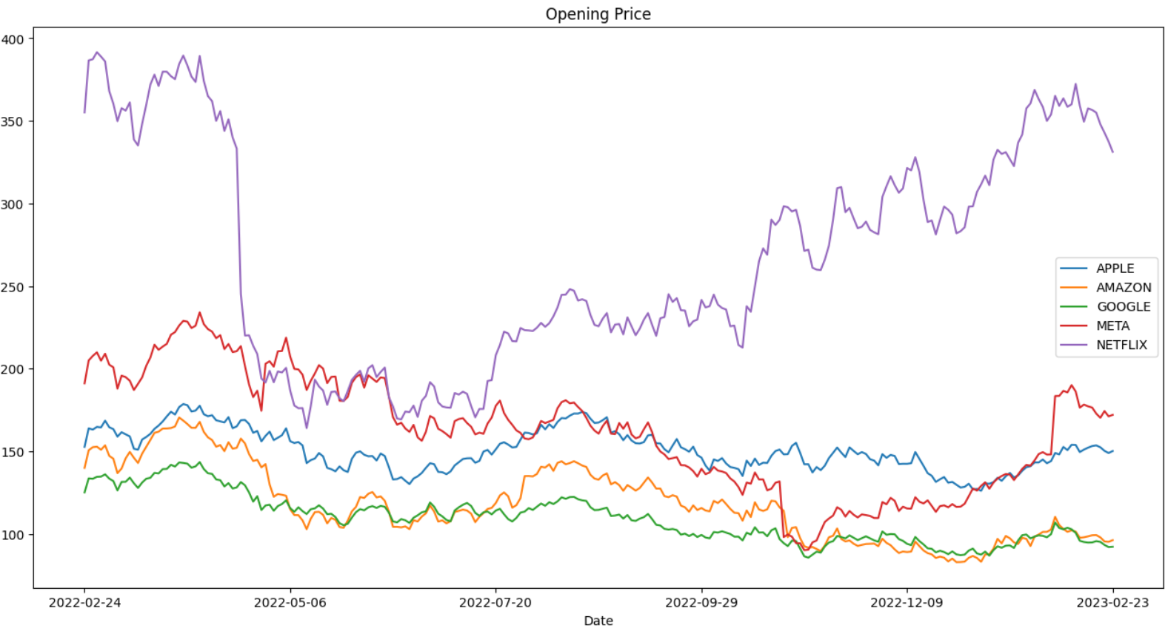
Stock Open Price Trends For Five Companies
Notes:
Here is the stock Open price data visualization from those five companies’ dataset.
The date range is from 2022-02-24 to 2023-02-23. We can see the trends for the ‘Big Tech’ stocks Open price are similar. This suggests other companies' data would be helpful to predict Apple stock Open price.

Slide 10
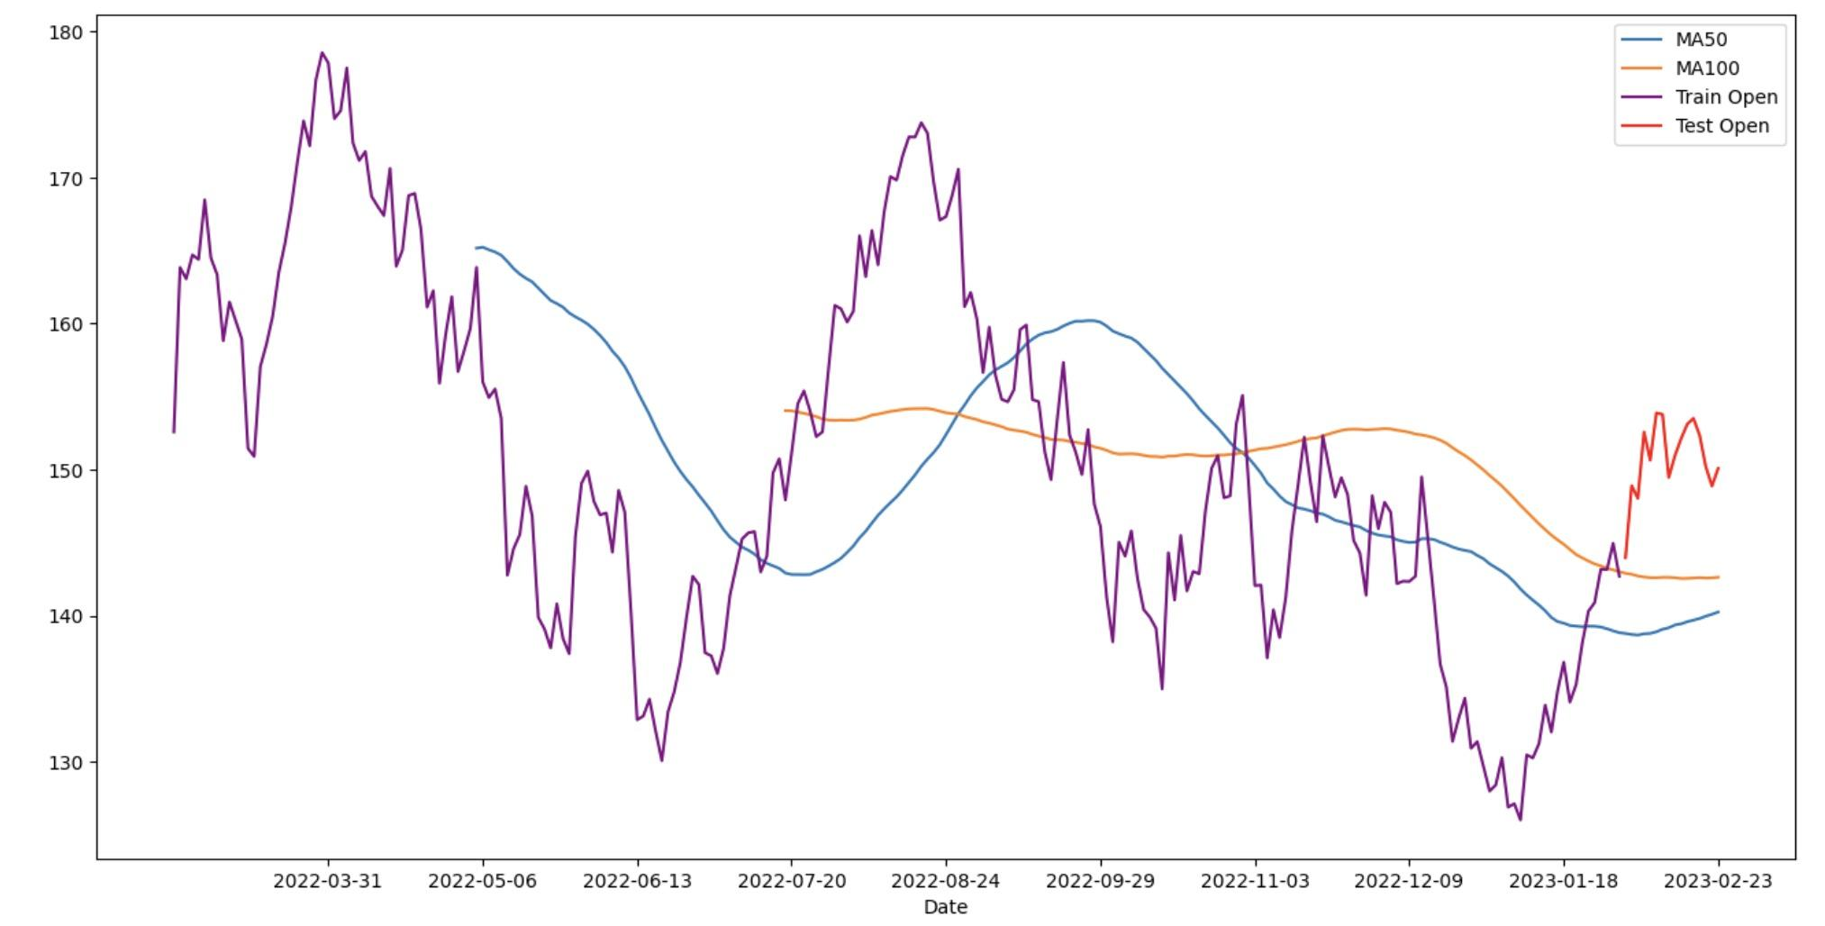
Train and Test Data Split
Training Data: all data except the last month's data (from 2022-2-24 to 2023-1-31)
Test Data: last month’s data (from 2023-02-01 to 2023-02-23)
Apple Stock Open Price Trends
Notes:
Here is the trends for Apple Stock Open Price in 50 days and 100 days.
MA50 shows the mean of Open price in 50 days.
And the MA100 shows the mean of Open price in 100 days.
We can see that the stock is relatively stable. It also proved the Apple Stock is worthy to invest.

Slide 11
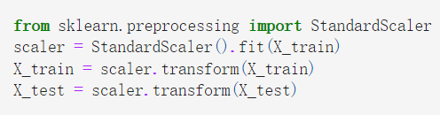
Input Processing
Preprocessing, Selection and Extraction
Standardization
Resulting dataset has all features with a mean of zero and a variance of one
Necessarily for k-Nearest Neighbor, Logistic Regression and Principal Component Analysis
Not required for decision trees, random forests, and gradient boosting algorithms
Notes:
Before fitting the models, we normalise the dataset using the standard scaler.
Standardization is a data preprocessing technique that scales the features of a dataset to have zero mean and unit variance, which can be useful for some machine learning algorithms, including KNN, Logistic Regression and PCA.
It's important to note that not all machine learning algorithms require standardization, and the decision to standardize data should be evaluated on a case-by-case basis. For example, decision trees, random forests, and gradient boosting algorithms do not require standardization.

Slide 12

Input Extraction
Principal Component Analysis (PCA)
A linear technique that can be used in many machine learning model that involves high-dimensional data
Reducing dimensionality
Improving performance
Visualizing high-dimensional data
Feature extraction
Can be used in linear regression, decision trees, random forest and k-NN
Notes:
One feature extraction process we used is the principal component analysis.
PCA (Principal Component Analysis) is a technique used for dimensionality reduction and feature extraction. It is used to identify patterns in high-dimensional data by reducing the number of variables while retaining the most important information.
PCA is a powerful tool that can be used to reduce the complexity of high-dimensional data, improve the performance of machine learning algorithms, and identify patterns in the data.
PCA can be used in any machine learning models, including linear regression, decision trees, random forest and k-NN. However, in this project, we only apply PCA on decision tree and linear regression.
From this GIF graph, we can see that as the line rotates, the projection of each data points (also the features captured by the line) are different. And then, the two dimension data points would be transformed into 1-d data points. Our goal is to find the principal components that are linear combinations of the features to reduce the dimensionality of our dataset.

Slide 13

Machine Learning Models
Linear Regression
k-NN
Decision Tree
Random Forest
Notes:
Now, let’s give a brief introduction to the ML models that we will apply.

Slide 14
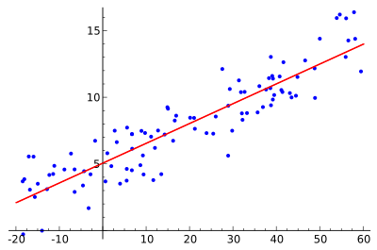
Linear Regression
A supervised machine learning algorithm to model the relationship between a dependent variable and one or more independent variables
Notes:
The first model we applied is Linear Regression model.
Linear regression is a supervised machine learning algorithm used to model the relationship between a dependent variable and one or more independent variables. It is a simple and widely-used approach to predicting a quantitative response based on the values of one or more predictors.

Slide 15
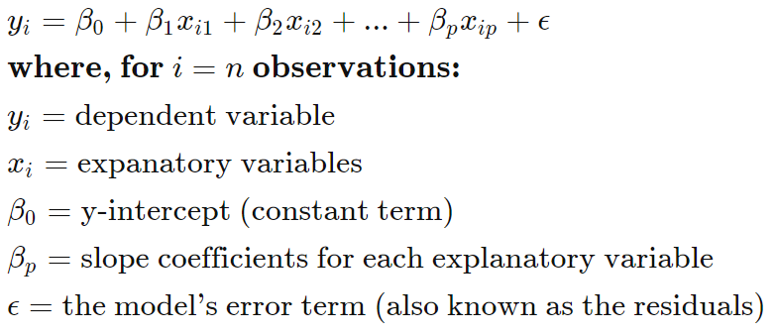
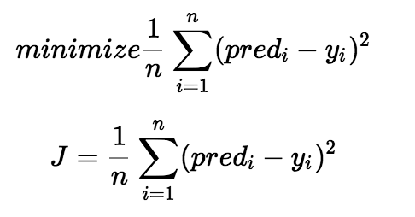
Linear Regression
General Equation
General Equation
Cost Function
Notes:
Here is the formula for the multiple linear regression.
In this formula, the beta-0 is the constant; those Xis are the explanatory variables (predictor attributes or features); the beta-p are the slope coefficients (or weights) for the corresponding variable; the yi is the dependent variable which is our target (APPLE’s ‘Open’ value in dataset). And the epsilon is the error of the formula, which we cannot get rid of.
Here is the cost function for the linear regression.
Our goal is to minimize the error differences as shown in the first formula. We square the error difference and sum over all data points and divide that value by the total number of data points. This provides the average squared error over all the data points. Therefore, this cost function is also known as the Mean Squared Error (MSE) function. Then we can change the values of the weights (betas) including the constant to minimize the cost function.
Moreover, this cost function can also be used in other machine learning models to have a better prediction.

Slide 16
Linear Regression - Model Tuned Parameters
Without Feature Selection
All input features are used for training the model.
Aim to minimize the difference between the predicted target variable and the actual target variable.
Minimizing a cost function through gradient descent.
The hyperparameters that need to be tuned are the learning rate, regularization strength, and the number of iterations or epochs for training.
Notes:
When it comes to tuning the model parameters, there are two scenarios to consider: With feature selection and Without feature selection. In without feature selection scenario, all input features are used for training the model. The model parameters are then tuned to minimize the difference between the predicted target variable and the actual target variable. This tuning is done by minimizing a cost function, typically the mean squared error (MSE), through a process called gradient descent. The hyperparameters that need to be tuned in this scenario are the learning rate, regularization strength,, and the number of iterations or epochs for training.

Slide 17
Linear Regression - Model Tuned Parameters
With Feature Selection
A subset of input features is selected based on their relevance and importance to the target variable.
Using feature selection techniques like principal component analysis (PCA).
Once the subset of features is selected, the model parameters are tuned using the same process as in the without feature selection situation.
Notes:
In with feature selection scenario, a subset of input features is selected based on their relevance and importance to the target variable. This can be done using various feature selection techniques like correlation analysis and principal component analysis (PCA). Once the subset of features is selected, the model parameters are tuned using the same process as in the previous scenario.

Slide 18
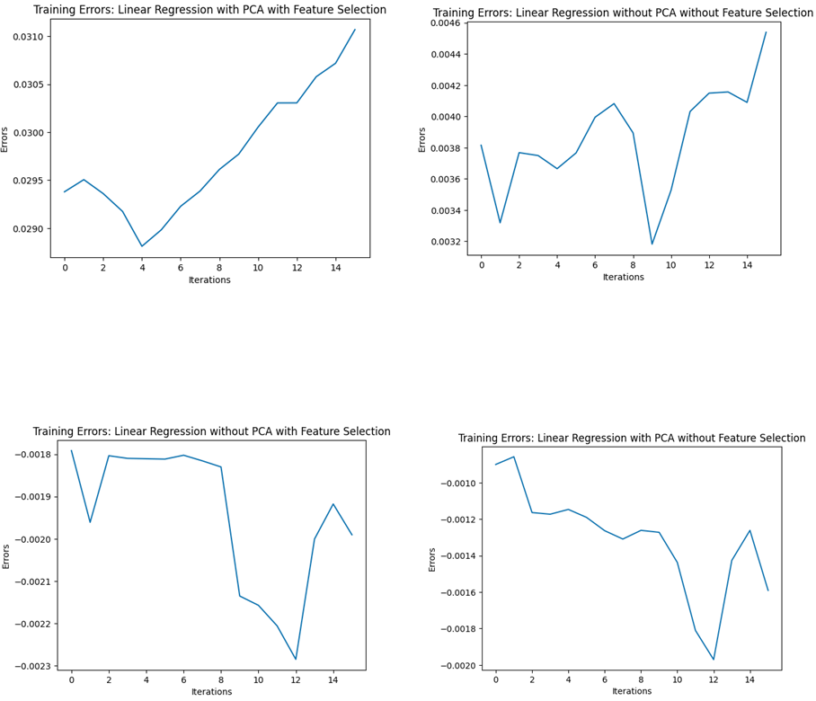
Linear Regression - Performance
Notes:
The training dataset was used to evaluate the performance of the linear regression models with and without PCA and feature selection.
The mean training errors were calculated for each model. The four plots generated from the evaluation show a similar trend for all models, with decreasing errors in the initial iterations followed by an increase in errors in the later iterations. This suggests that the models may be overtrained.
Despite the observed increase in errors, the range of fluctuation for the errors is less than 0.2%, which is considered acceptable. If The y-axis range for errors were changed to match real-life magnitudes, the observed increase in errors would not be significant.

Slide 19
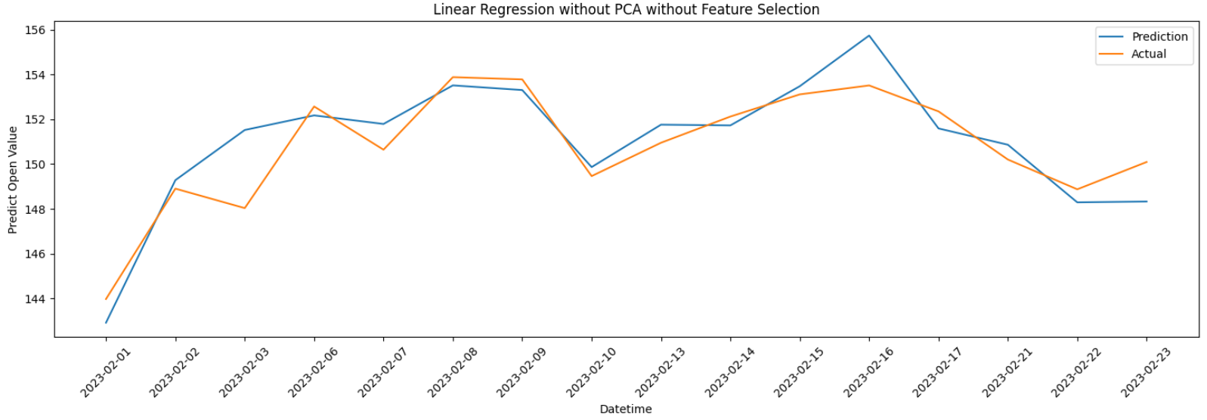
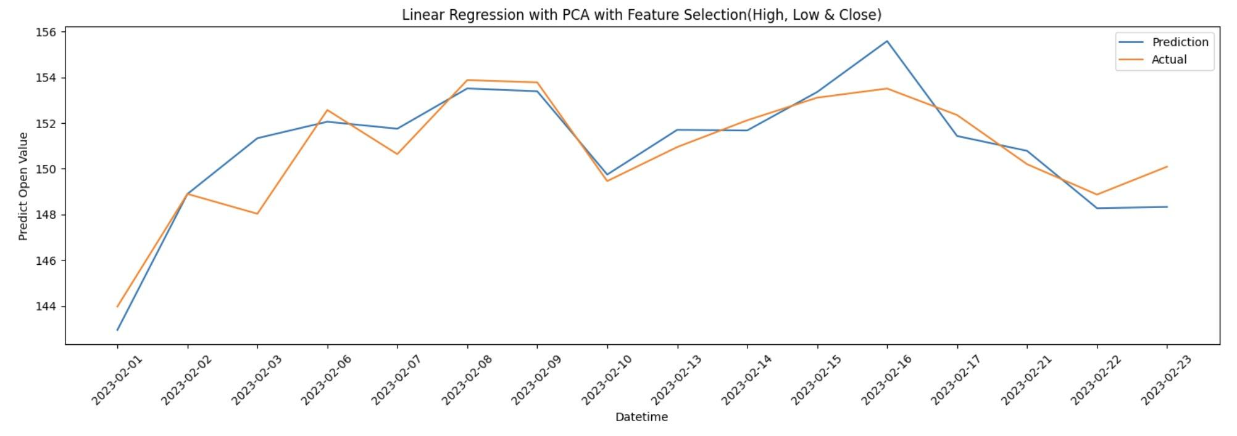
Linear Regression without PCA
Accuracy = 99.36%
Avg. Error = 0.9552°
Test Data
Equity Curves
Metrics
Accuracy = 99.40%
Avg. Error = 0.8990°
Notes:
By using Linear Regression model without PCA, we tried prediction through selecting all features and selecting partial important features.
The top graph is the model with all features; the accuracy is 99.36%.
And bottom graph is the model that we select High, Low and Close features; the accuracy is 99.4%.

Slide 20
Linear Regression with PCA
Accuracy = 99.36%
Avg. Error = 0.9617°
Test Data
Equity Curves
Metrics
Accuracy = 99.41%
Avg. Error = 0.8817°
Notes:
By using Linear Regression model with PCA, we also tried prediction through selecting all features and selecting partial important features.
The top graph is the model with all features; the accuracy is still 99.36%.
And bottom graph is the model that we select High, Low and Close features; the accuracy is 99.41%.
Although results are similar, the LR model with PCA and with Feature selection still slightly improved the accuracy.

Slide 21

k-Nearest Neighbors (k-NN)
Given a new data point, the KNN algorithm searches the training dataset for the K nearest data points, based on some distance metric.
The predicted class or value for the new data point is then determined based on the class or value of the majority of the K nearest neighbors.
Notes:
K-Nearest Neighbors (KNN) is a machine learning algorithm used for both classification and regression problems. It is a non-parametric and lazy learning algorithm, which means that it does not make any assumptions about the underlying distribution of the data, and does not learn a model from the training data. Instead, it simply stores the entire training dataset and uses it for making predictions on new data points.
Given a new data point, the KNN algorithm searches the training dataset for the K nearest data points, based on some distance metric (usually Euclidean distance or Manhattan distance). The predicted class or value for the new data point is then determined based on the class or value of the majority of the K nearest neighbors.
However, it can be sensitive to the choice of the distance metric and the value of K, and can become computationally expensive for large datasets. Therefore, standardizing the data is required.

Slide 22
k-NN - Model Tuned Parameters
Parameters | Values Searched | Best
n_neighbors | range(1, 21, 4) | 17
leaf_size | range(1, 31, 4) | 1
p | [1, 2] | 1
weights | [‘uniform’, ‘distance’] | ‘distance’
metric | [‘minkowski’, ‘chebyshev’] | ‘minkowski’
Notes:
We perform grid search on these parameters, and the best parameters are{'leaf_size': 1, 'metric': 'minkowski', 'n_neighbors': 17, 'p': 1, 'weights': 'distance'}.

Slide 23
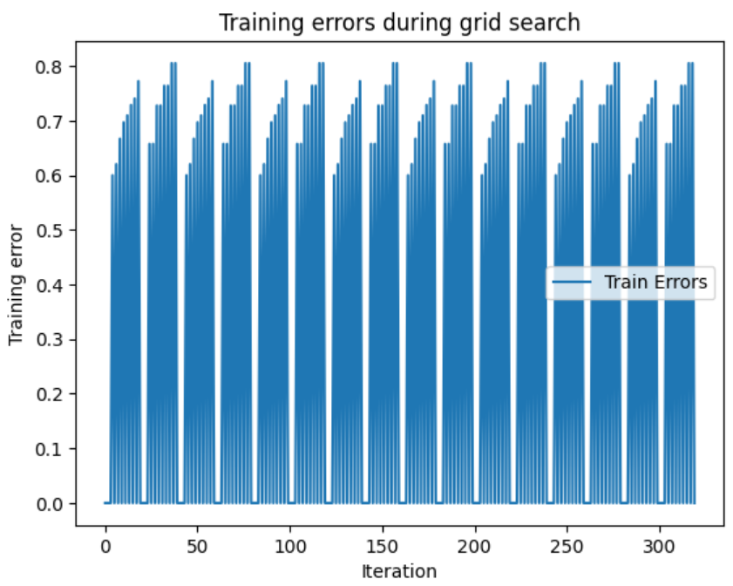
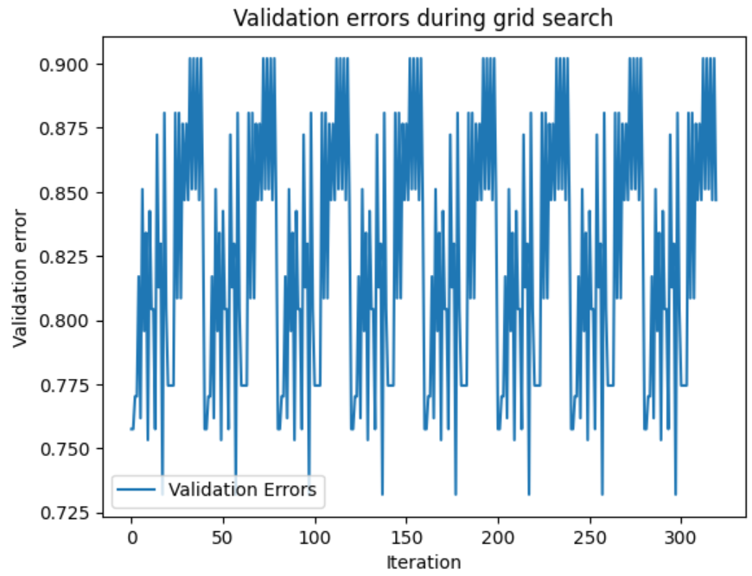
k-NN - Performance
Notes:
Evaluation of the model on the training dataset calculates training errors. k-NN predicts by determining the distance between each point in the training dataset and its k nearest neighbors. Training errors may indicate the model's capacity to generalize to new data, but they may not.
A validation set or hold-out test set is used to calculate validation errors. k-NN predicts by determining the distance between each validation dataset point and its k nearest neighbors. Validation errors can be used to alter hyperparameters like k.
Monitoring training and validation errors prevents overfitting. The model may be overfitted if the training error is much lower than the validation error. In this case, the validation error is higher than training errors so the model is overfit. To improve generalization, modify the model's complexity or regularization parameters.

Slide 24
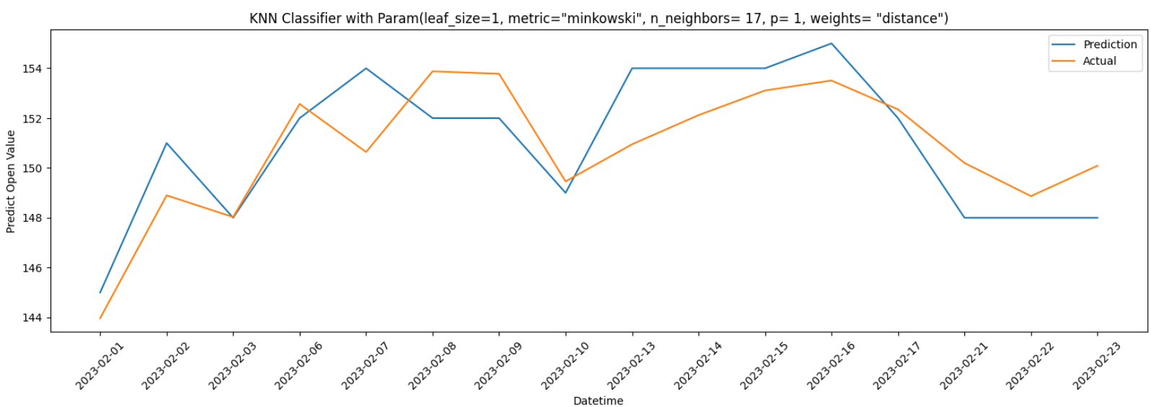
k-NN
Test Data
Equity Curves
Metrics
Accuracy = 99.01%
Avg. Error = 1.5019°
Notes:
By tuning the parameters, we found for KNN Classifier with best parameters, the accuracy is 99.01%, which is slightly poorer than the one from linear regression.

Slide 25

Decision Tree
A tree-based model that partitions the data into subsets based on a series of binary decisions made on the input features
Notes:
Decision tree is a popular machine learning algorithm used for classification and regression tasks.
It creates a model in the form of a tree structure, where each internal node represents a test on an attribute, each branch represents the outcome of the test, and each leaf node represents a class label or a numerical value.
The decision tree is constructed by recursively splitting the data based on the attribute that provides the most information gain, which measures the reduction in entropy or impurity after the split.
Decision trees are easy to interpret and visualize, and can handle both categorical and continuous data.
However, they can suffer from overfitting and can be unstable with small variations in the data.

Slide 26
Decision Tree - Model Tuned Parameters
Parameters | Values Searched | “Best”
criterion | [‘gani’, ‘entropy’] | ‘gani’
min_samples_leaf | [5, 10, 20, 50, 100] | 5
min_samples_split | range(2, 22, 2) | 4
max_features | ['auto', 'sqrt', 'log2'] | ‘auto’
pca_n_components | [1, 2, 3, 4, 5] | 4
Notes:
We perform grid search on these parameters, and the best parameters are{{'dec_tree__criterion': 'gini', 'dec_tree__max_features': 'auto', 'dec_tree__min_samples_leaf': 5, 'dec_tree__min_samples_split': 4, 'pca__n_components': 4}.
It should be noticed that this “best model” through tuning has an accuracy lower than its default model.

Slide 27
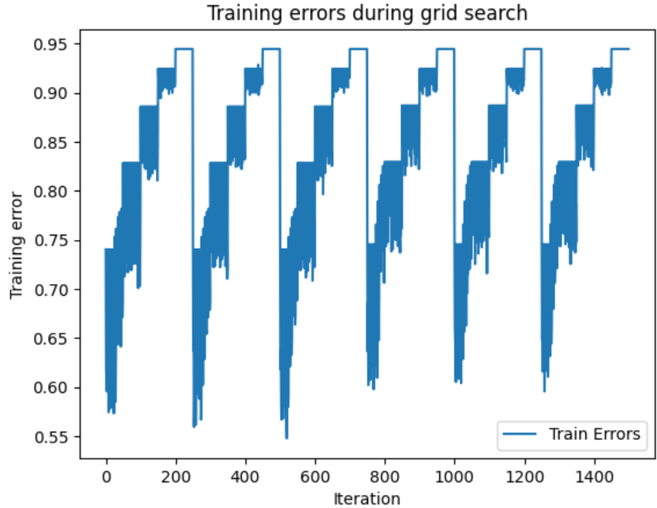
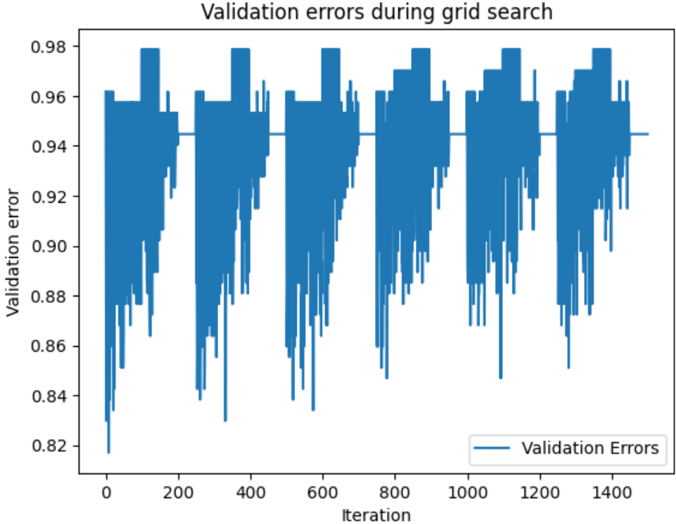
Decision Tree - Performance
Notes:
Training mistakes are determined through the model's evaluation on the dataset used for training. The decision tree is then trained on the data and its predictions are tested using the same data. Whether or not a model can generalize to new data can be inferred from training errors.
Validation mistakes are typically determined by using a validation set or hold-out test set. Accuracy is measured by applying the trained tree to the validation dataset and making predictions. Adjusting hyperparameters like the maximum tree depth or the minimum number of samples needed to divide a node can be informed by validation errors, which reveal how well the model generalizes to new data.
Overfitting can be avoided with careful monitoring of training and validation mistakes. If the validation error is significantly larger than the training error, the model may have been overfit. In this case, the validation error is higher than training errors so the model is overfit. Changing the model's regularization or complexity parameters can help with generalization.

Slide 28
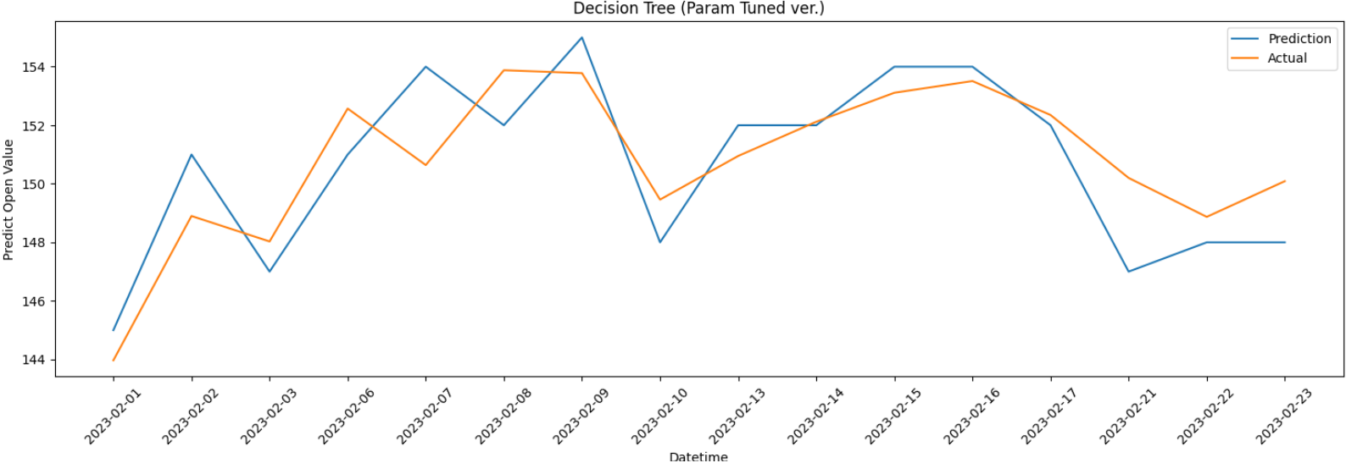
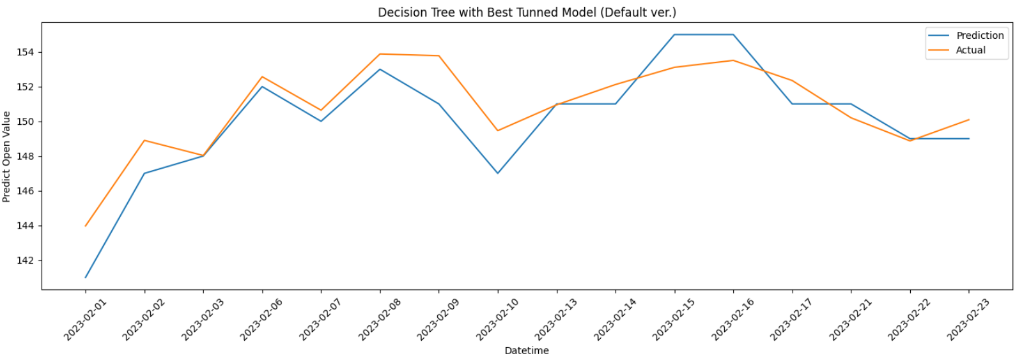
Decision Tree
Accuracy = 99.06%
Avg. Error = 1.4194°
Test Data
Equity Curves
Metrics
Accuracy = 9916%
Avg. Error = 1.2594°
Notes:
In decision tree model, the situation is a little bit different and interesting.
Although we found the best model through tuning the parameters and get the best decision tree model (the top graph). The accuracy is lower than its default model (lower graph) with an accuracy at 99.16%.

Slide 29

Random Forest
An ensemble learning method that constructs a multitude of decision trees at training time and combines them into a forest
Notes:
Next, we will introduce the random forest regression model. Random forest is an ensemble learning method that constructs a multitude of decision trees at training time and combines them into a forest. Random Forest improves upon decision trees by using bootstrap aggregating and random feature selection to reduce overfitting and increase accuracy. During prediction, the Random Forest model outputs the mode (for classification) or mean (for regression) of the predictions of the individual trees in the forest.
In our model, we give all features to the random forest as input. Through its random feature selection, we can get the prediction values that reduce overfitting and increase accuracy.

Slide 30
Random Forest - Model Tuned Parameters
Parameters | Values Searched | Best
bootstrap | [True, False] | ‘False’
max_depth | [10, 20, 30, 40, 50, 60, 70, 80, 90, 100, 110, None] | 50
max_features | ['auto', 'sqrt'] | 'sqrt'
min_samples_leaf | [1, 2, 4] | 2
min_samples_split | [2, 5, 10] | 2
n_estimators | [200, 400, 600, 800, 1000, 1200, 1400, 1600, 1800, 2000] | 800
Notes:
We perform grid search on these parameters, and the best parameters are{'n_estimators': 800, 'min_samples_split': 2, 'min_samples_leaf': 2, 'max_features': 'sqrt', 'max_depth': 50, 'bootstrap': False}.

Slide 31
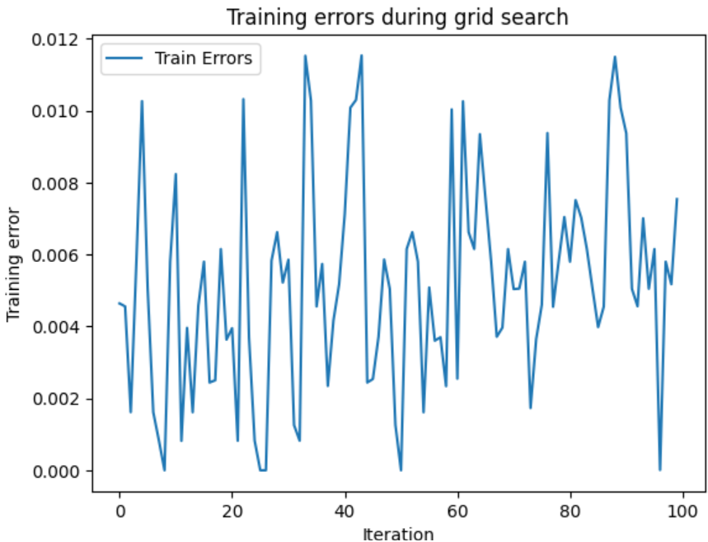
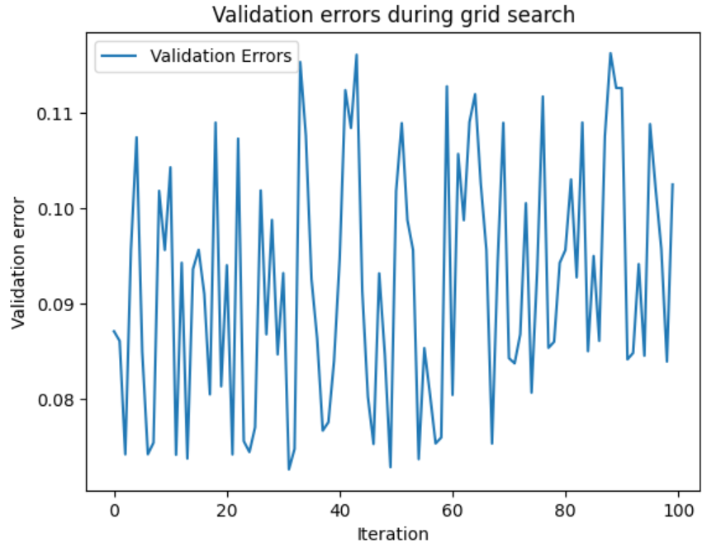
Random Forest - Performance
Notes:
Training mistakes are determined through the model's evaluation on the dataset used for training. This is done in Random Forest by training an ensemble of decision trees and then testing their accuracy on the same dataset to see how well they forecast. Whether or not a model can generalize to new data can be inferred from training errors.
Validation mistakes are typically determined by using a validation set or hold-out test set. The goal of this step in Random Forest is to measure the accuracy of the ensemble of decision trees by making predictions on the validation dataset. Adjusting hyperparameters like the number of trees in the forest, their maximum depth, and the minimum number of samples needed to divide a node can be informed by validation failures, which reveal how well the model generalizes to new data.
To achieve the best results on the validation set, grid searches optimize the hyperparameters of the Random Forest model. To prevent overfitting, keep an eye on the error rates in both the training and validation phases when adjusting the hyperparameters. If the validation error for a particular set of hyperparameters is significantly smaller than the training error, then overfitting may have occurred. In our model, the validation errors are smaller than training errors so our model is OK.

Slide 32
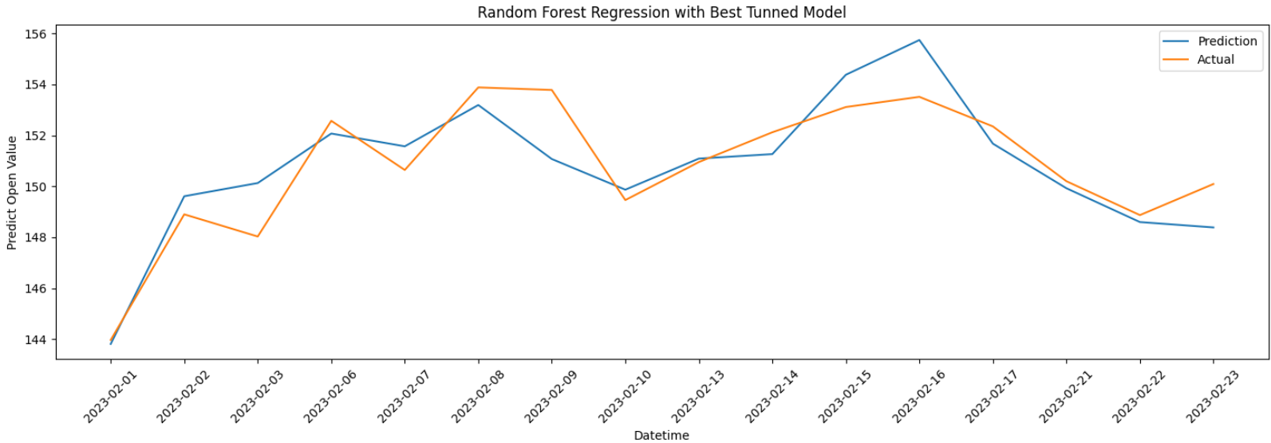
Random Forest
Test Data
Equity Curves
Metrics
Accuracy = 99.36%
Avg. Error = 0.9761°
Notes:
By tuning the parameters, we found the best random forest has an accuracy of 99.36%.

Slide 33
Result Comparison
Model | Highest Accuracy
LR without PCA | 99.4%
LR with PCA | 99.41%
Random Forest | 99.36%
KNN | 99.01%
Decision Tree | 99.16%
Notes:
From the table, we can see the LR with feature selection with PCA has the best prediction performance with the highest accuracy at 99.41%. And KNN is the most unreliable model to predict APPLE stock prices.

Slide 34
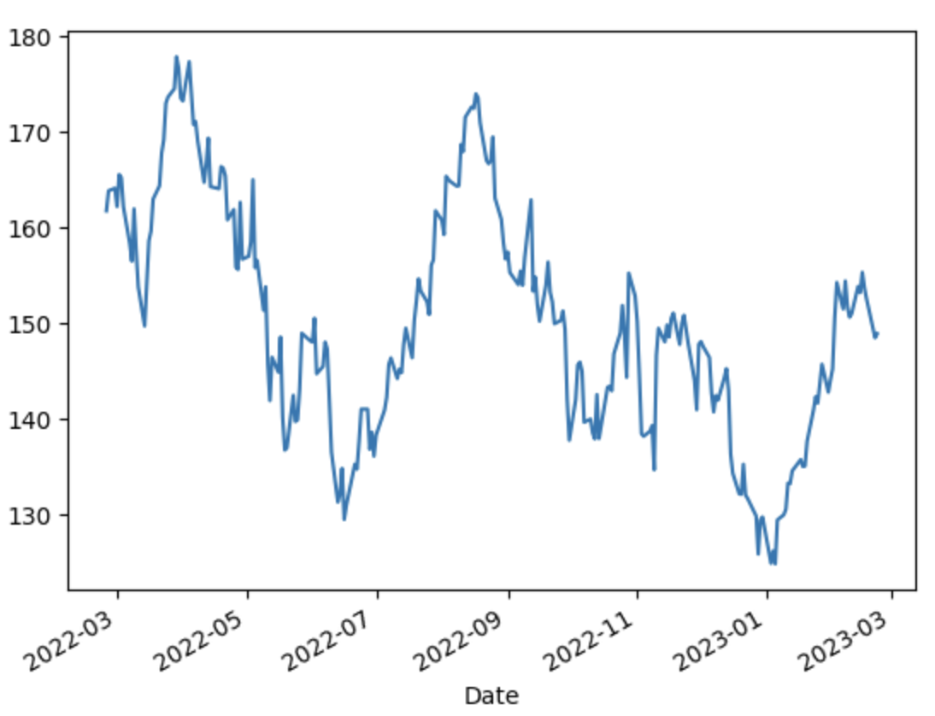
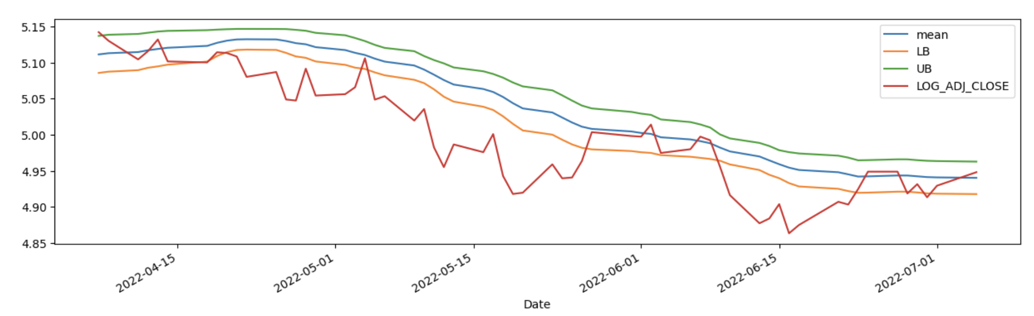
White Reality Check
Notes:
There are some results plots generated from the white reality check. Let’s talk about them one by one.
For the left plot, it shows the line for the stock market pricing of APPLE.
The right one shows the mean lower boundary and upper boundary and the Adj close feature.

Slide 35
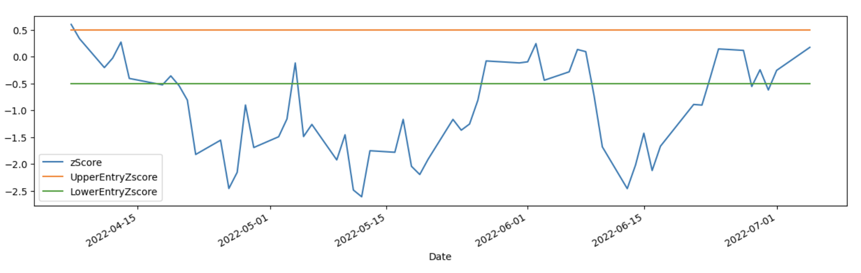
Z-score
Notes:
This plot shows the Z-score calculation with different data, and the upper and lower entry.
The z-score is a statistical measure that represents the number of standard deviations a data point is from the mean of a dataset. In the context of stock data, the z-score is used to determine how far a particular stock's price is from its average price over a given period of time. A positive z-score indicates that the stock's price is above its average, while a negative z-score indicates that the stock's price is below its average.
The UpperEntryZscore and LowerEntryZscore are commonly used in trading strategies based on mean reversion. These z-scores represent the threshold values beyond which a stock's price is considered overbought or oversold, respectively. Traders may use these values as entry signals for trades, where they buy the stock when the price is below the LowerEntryZscore and sell when the price is above the UpperEntryZscore.

Slide 36
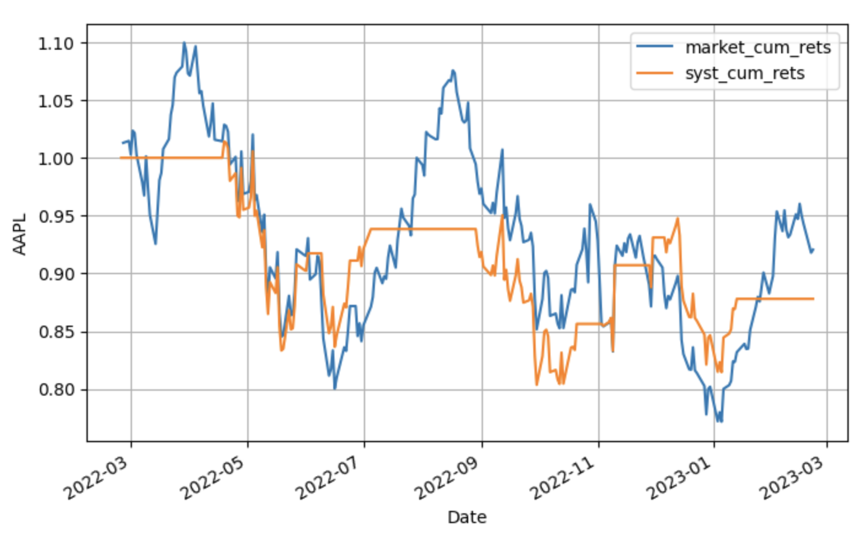
Cumulative Returns
Notes:
This plot is a visualization of the cumulative returns of a stock trading system.
The market_cum_rets line represents the cumulative returns of a benchmark market index, such as the S&P 500 or the NASDAQ Composite. This line shows the performance of the broader market over the same period of time as the trading system.
The syst_cum_returns line represents the cumulative returns of the trading system. This line shows the performance of the trading system over the same period of time as the benchmark market index.
By comparing the two lines, you can evaluate the performance of the trading system relative to the broader market. If the syst_cum_returns line is consistently higher than the market_cum_rets line, the trading system is said to have outperformed the market. If the syst_cum_returns line is consistently lower than the market_cum_rets line, the trading system is said to have underperformed the market.

Slide 37
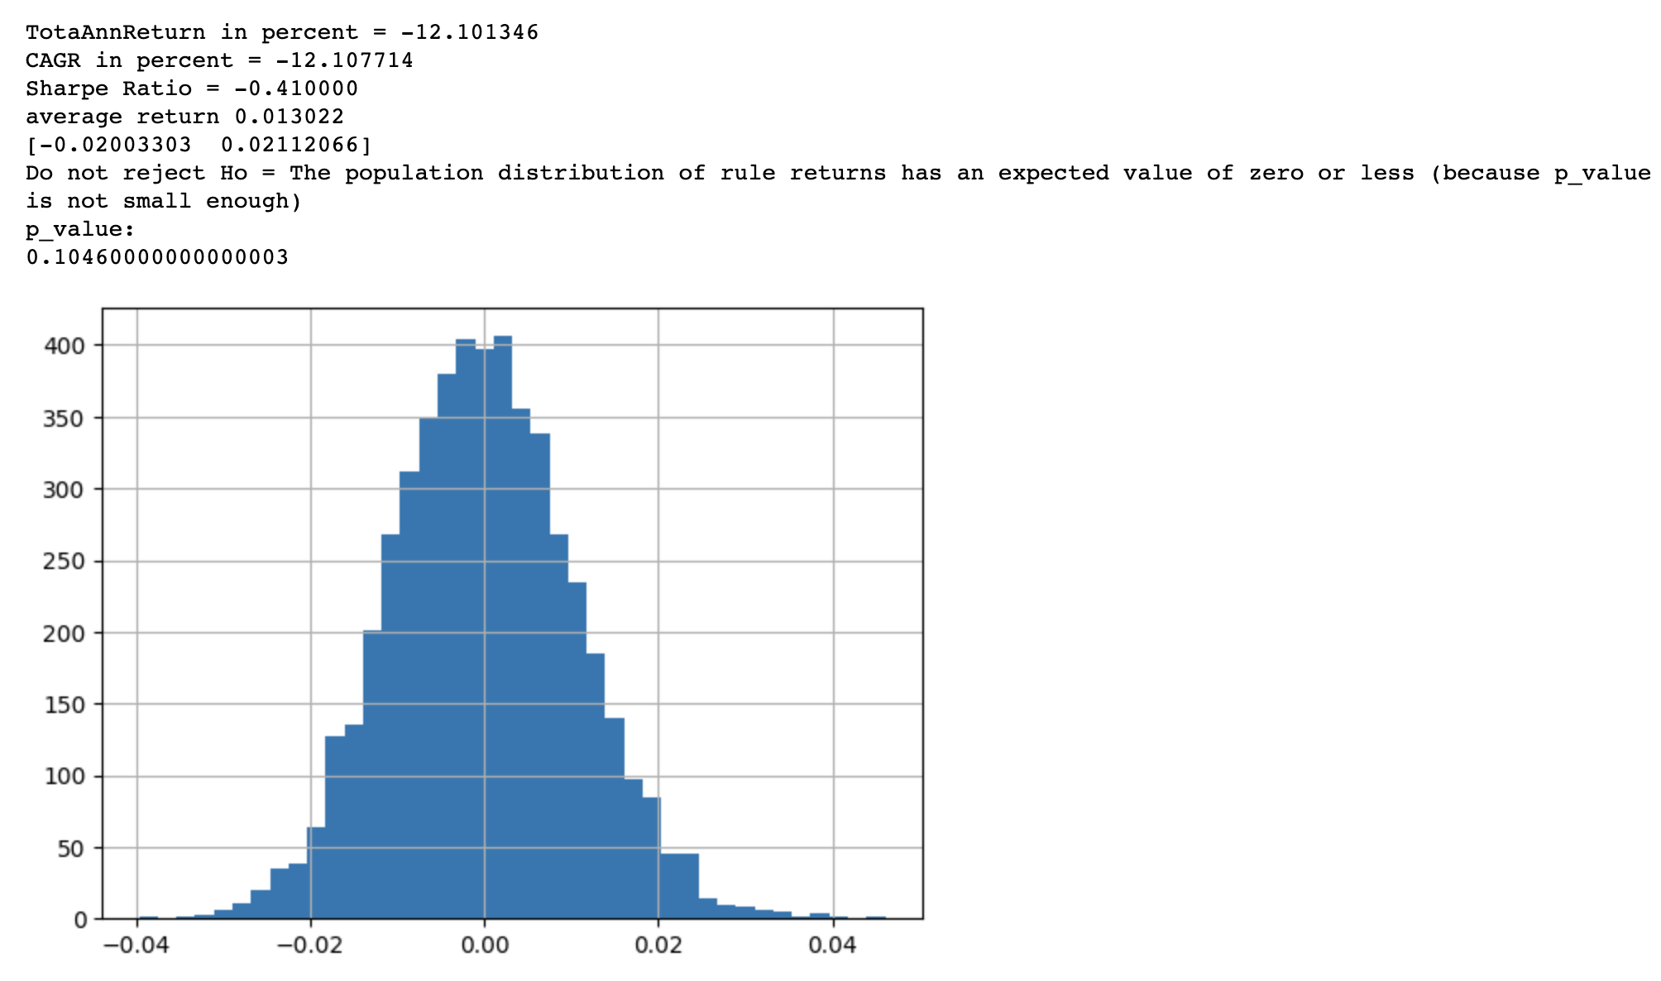
Result Summary
Notes:
Here is the result of the white reality check. The results of the White Reality Check of Apple shows that the trading system being evaluated has produced negative returns, with a total annual return of -12.10% and a compounded annual growth rate (CAGR) of -12.11%. Additionally, the Sharpe Ratio is negative, indicating that the trading system has not generated a sufficient return relative to the level of risk taken.
The average return of 0.013022 indicates that, on average, the trading system has produced a small positive return, but the negative returns have outweighed the positive returns.
The next line of output, [-0.02003303 0.02112066], provides the confidence interval for the average return, which indicates that with 95% confidence, the true average return of the trading system is expected to fall between -0.02003303 and 0.02112066.
The p-value of 0.10460000000000003 indicates that the null hypothesis that the population distribution of the rule returns has an expected value of zero or less cannot be rejected at the 5% significance level. This means that the evidence is not strong enough to conclude that the trading system's returns are significantly different from zero or less.
Overall, the results suggest that the trading system has not performed well.

Slide 38
Conclusion
Linear Regression with PCA is the best model to predict APPLE stock values.
APPLE stock currently does not perform well, be caution to buy the stocks.
Possible reasons: Pandemic & Bad Economy
Notes:
In conclusion, in this study, the linear regression model with PCA performs best to predict APPLE stock values. However, currently, APPLE stock does not perform well in the past year, this might be caused by pandemic, economy reasons (bad economy, inflation) from pandemic recovery.

Slide 39
Thank You
ACKNOWLEDGEMENT
Prof. Sabatino Costanzo-Alvarez
&
Prof. Rosario Lorenza Trigo-Ferre
Notes:
Thanks to Professors Sabatino Costanzo-Alvarez and Rosario Lorenza Trigo-Ferre for their teaching and guidance this semester.
Thank you for watching and listening.

